Slide 1

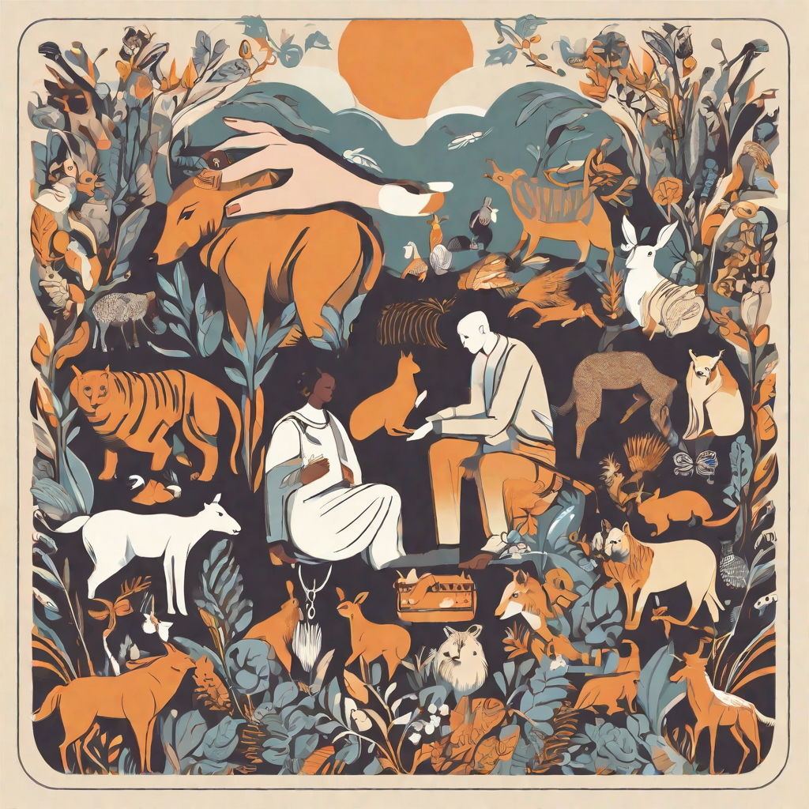
ETHICS AND ANIMAL RIGHTS
PRESENTED BY: PAMAS KULUNG RAI, RONAK POUDEL, SHEKH ATIULAH AND SUJAN THING

Slide 2
Introduction
Ethics and animal rights are important topics that have a significant impact on society. The way we treat animals reflects our values and moral principles. It is crucial to recognize the rights of animals and ensure their ethical treatment. By doing so, we contribute to a more compassionate and just society.

Slide 3
Historical Perspective
Throughout history, the treatment of animals has varied greatly depending on cultural, societal, and economic factors. In ancient times, animals were often seen as resources to be used for survival and economic gain. They were used for labor, transportation, and food, and their well-being was not a significant consideration.
In the 19th century, the animal rights movement gained traction, with activists advocating for the humane treatment of animals and the prevention of cruelty. This led to the establishment of animal protection laws and the formation of organizations dedicated to animal welfare.
In recent decades, there has been a growing recognition of animals' capacity for pain, emotions, and cognitive abilities. Today, there is a greater emphasis on animal rights and ethical considerations in various aspects of society, including agriculture, entertainment, and scientific research. Many countries have enacted laws to protect animals from cruelty and promote their well-being, and public awareness and support for animal rights continue to increase.

Slide 4
Animal Welfare vs. Animal Rights
Animal Welfare
Animal welfare refers to the ethical responsibility of humans to provide for the well-being and proper treatment of animals. It focuses on ensuring that animals are free from unnecessary suffering and have access to basic needs such as food, water, shelter, and medical care.
Animal Rights
Animal rights is a broader philosophical and ethical stance that argues for the inherent rights of animals to be treated with respect, dignity, and equality to humans. It advocates for the abolition of all forms of animal exploitation, including the use of animals for food, clothing, entertainment, and scientific research.

Slide 5
Ethical Considerations: Treatment of Animals
The treatment of animals raises important ethical considerations, with differing perspectives on animal rights and welfare. Here are some key arguments:
Animal welfare and Animal rights
The concept of animal welfare focuses on ensuring that animals are provided with proper care, minimizing their suffering and promoting their well- being. Advocates for animal rights argue that animals have inherent value and deserve to be treated with respect and compassion.
Utilitarianism
Utilitarian arguments consider the overall happiness and suffering caused by human actions towards animals, weighing the benefits and harms.

Slide 6
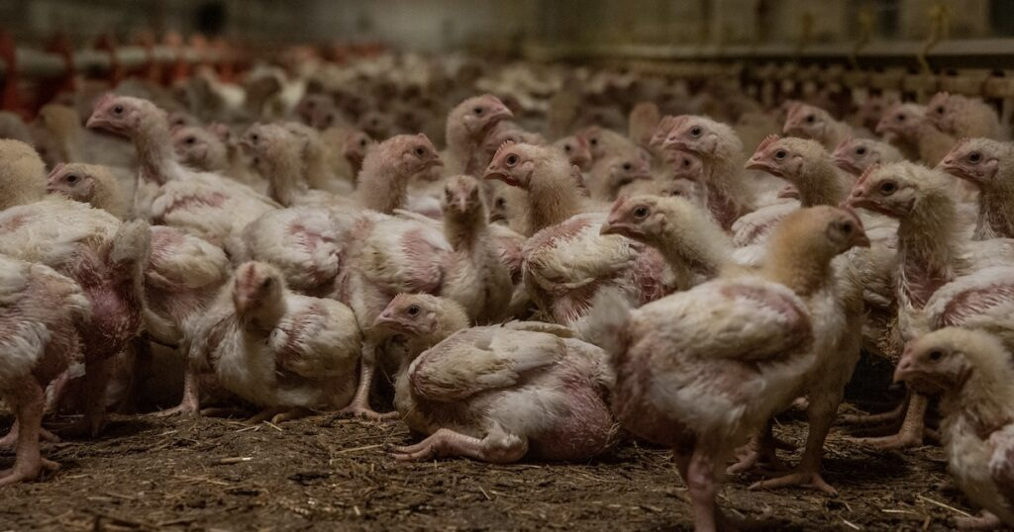
Factory Farming
Inhumane Conditions
Factory farming subjects animals to overcrowded and unsanitary conditions, causing immense suffering.
Animal Treatment
Animals in factory farms are often subjected to cruel practices such as confinement, mutilation, and neglect.

Slide 7
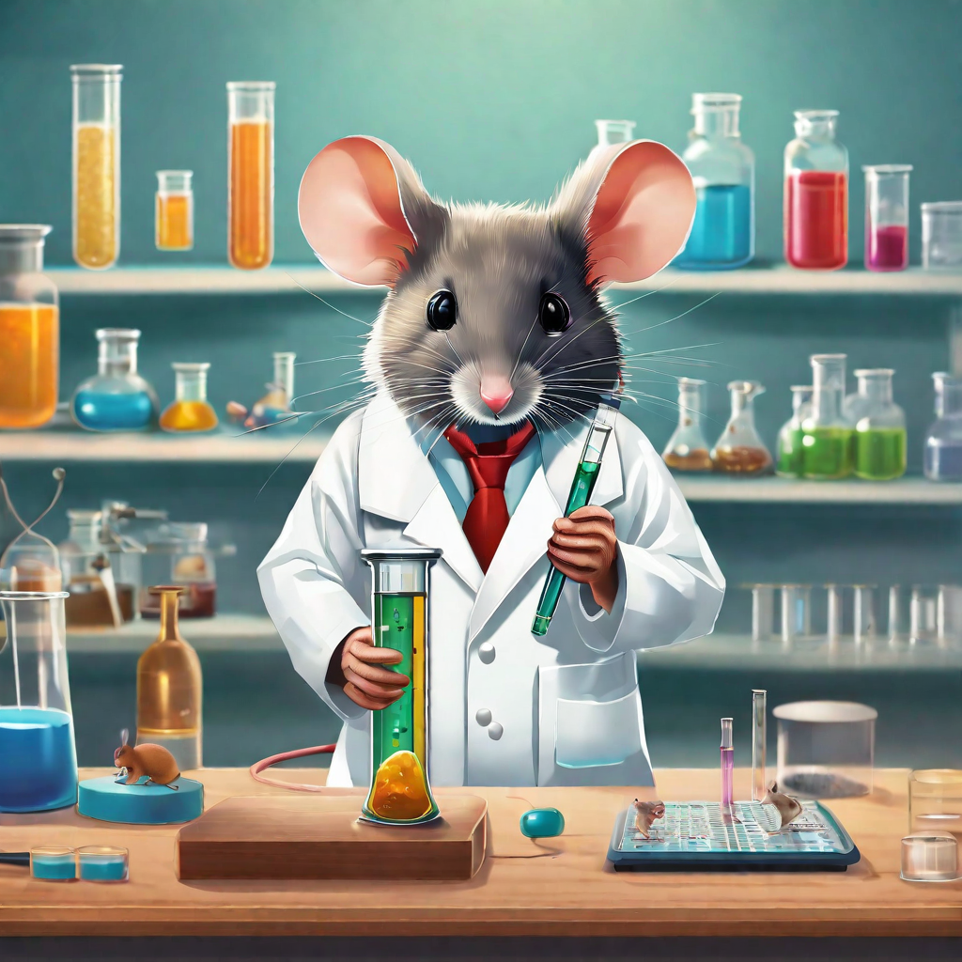
Animal Testing
Ethical Issues
Animal testing raises ethical concerns regarding the treatment and use of animals in scientific research.
Arguments For
Proponents argue that animal testing is necessary for medical advancements and ensuring human safety.
Arguments Against
Critics argue that animal testing is cruel, unnecessary, and that alternative methods should be used.

Slide 8
Wildlife Conservation
Importance of Wildlife Conservation
Wildlife conservation is crucial for maintaining the balance of ecosystems and preserving biodiversity.
Ethical Considerations
Wildlife conservation involves ethical considerations, such as respecting the intrinsic value of animals and their right to exist.
Impact of Human Activities
Human activities, such as habitat destruction, pollution, and poaching, have a significant impact on wildlife populations.

Slide 9
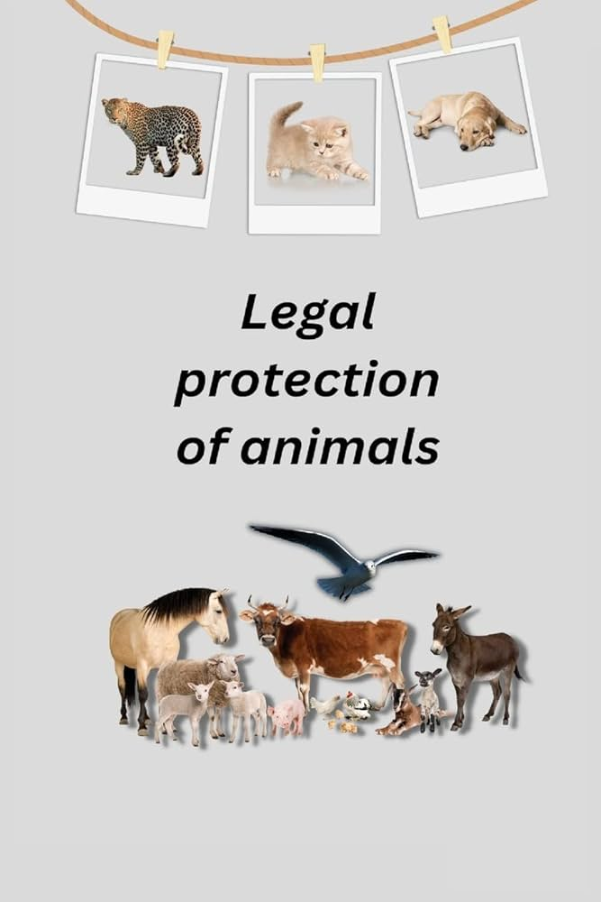
Legal Protection for Animals
Animal Welfare Laws
Different countries have implemented laws and regulations to protect the welfare of animals. These laws aim to prevent animal cruelty, ensure proper care and treatment of animals, and prohibit activities that harm animals.
Examples of Animal Protection Laws
United Kingdom: Animal Welfare Act 2006
United States: Animal Welfare Act (AWA)
Australia: Prevention of Cruelty to Animals Act 1979

Slide 10
Ethical Considerations of Veganism and Vegetarianism
Veganism and vegetarianism are dietary choices that have gained popularity due to their ethical considerations. These dietary choices prioritize animal welfare and the environment.
Impact on Animal Welfare
By adopting a vegan or vegetarian lifestyle, individuals contribute to reducing the demand for animal products, which in turn reduces the number of animals raised and slaughtered for food. This choice promotes the well-being and ethical treatment of animals.
Environmental Impact
The production of animal products, such as meat and dairy, has a significant environmental impact. Adopting a vegan or vegetarian lifestyle helps reduce greenhouse gas emissions, land degradation, and water pollution associated with animal agriculture. It also conserves resources like water and land.

Slide 11
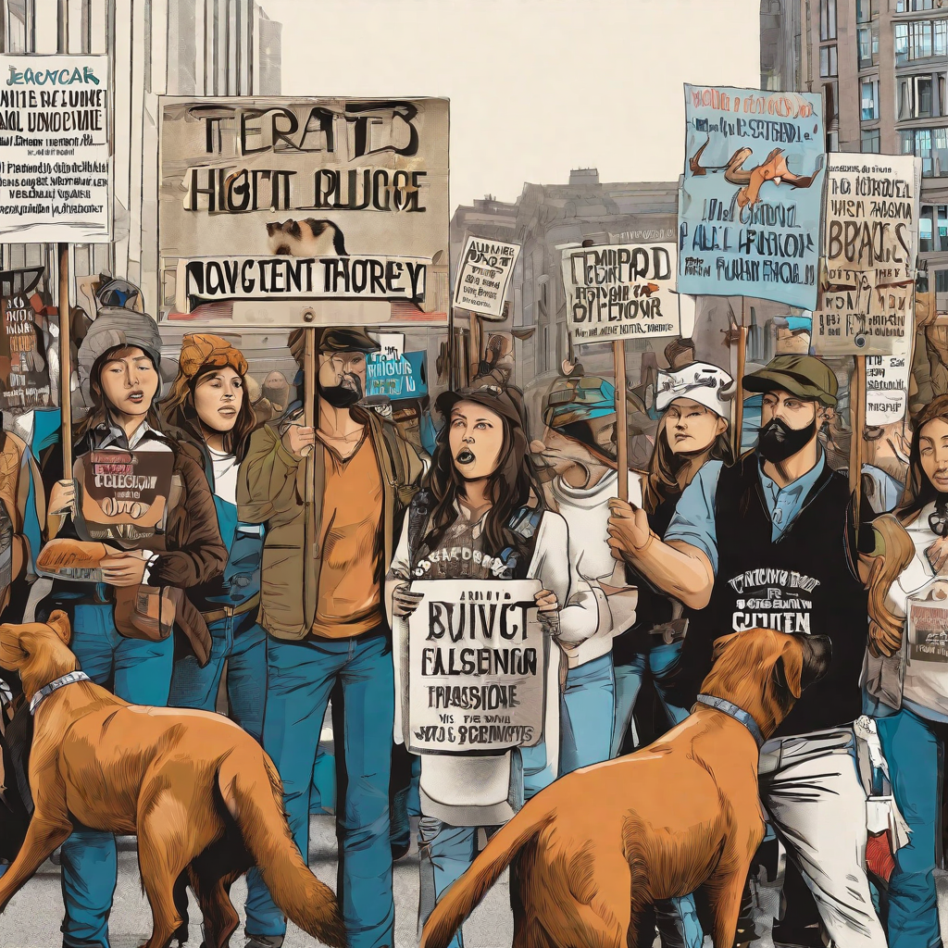
Animal Rights Activism
Animal rights activism plays a crucial role in advocating for the ethical treatment of animals and raising awareness about their welfare.
Efforts of Animal Rights Organizations
Promoting Veganism
Fighting against Animal Testing
Ending Fur and Exotic Skins Trade
Rescuing and Rehabilitating Animals

Slide 12
Animal Rights in Different Cultures
Hinduism (Nepal and India):
Reverence for Cows: In Hinduism, cows are considered sacred, and their protection is often emphasized. The slaughter of cows is banned in several Indian states, reflecting religious and cultural values.
Ahimsa (Non-violence): The principle of ahimsa, or non-violence, extends to animals in Hindu philosophy. This influences dietary choices, with many adherents adopting vegetarian or vegan lifestyles.
Islam (Middle East and Beyond):
Halal Practices: Islamic teachings include guidelines for the humane treatment of animals, particularly during slaughter. Halal practices emphasize quick and humane slaughtering methods.
Permissible Consumption: Certain animals are considered permissible (halal) for consumption, while others are prohibited (haram). The treatment of animals in the process of obtaining halal meat is a significant consideration for many Muslims.

Slide 13
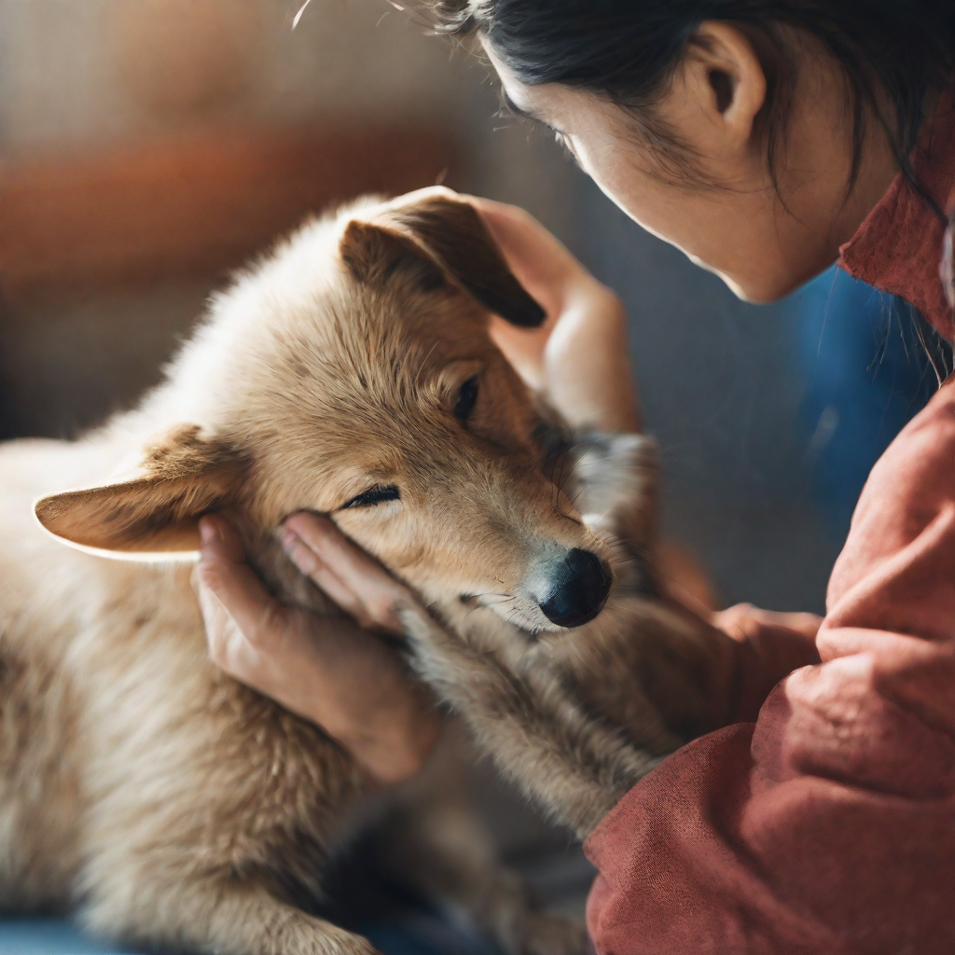
Link Between Animal Abuse and Human Violence
There is a growing body of research that suggests a link between animal abuse and human violence.
Research and Studies
Numerous studies have shown a correlation between animal abuse and human violence.

Slide 14
The Future of Animal Rights
Advancements in Animal Rights
The future of animal rights holds potential for advancements in several areas:
-Legislation and Policy: Stricter laws and regulations can be put in place to protect animals from cruelty and exploitation.
-Technological Innovations: Advances in technology can lead to the development of alternative methods for testing and research, reducing the need for animal testing.
Challenges in Animal Rights
However, there are also challenges that need to be addressed in the future:
-Cultural and Traditional Practices: Overcoming cultural and traditional practices that involve the mistreatment of animals can be a significant challenge.
-Economic Interests: Balancing the economic interests of industries that rely on animal exploitation with the ethical treatment of animals can be a complex issue.

Slide 15
The Role of Technology in Animal Rights
Advancing Animal Rights
Technology plays a crucial role in advancing animal rights by providing innovative solutions to monitor and protect animals.
Monitoring and Protecting Animals
Technology enables us to monitor and protect animals in ways that were previously unimaginable. From GPS tracking devices to remote camera systems, these tools help us gather data and ensure the safety and well-being of animals.

Slide 16
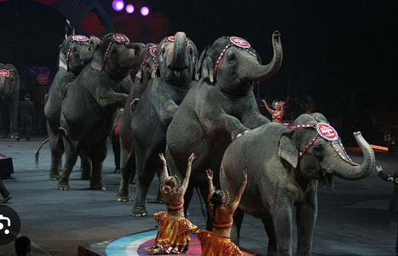
Ethical Considerations in Animal Entertainment
Animal entertainment raises a range of ethical considerations, particularly when animals are used for purposes such as circuses, zoos, aquariums, theme parks, and other forms of public entertainment.
It may involve cruelty in the way the animal is kept and transported. Animals can be taught to perform provided their minimum needs for food and shelter are met; proper respect for animals requires better treatment than the minimum.

Slide 17
The Impact of Animal Agriculture on the Environment
Deforestation
Animal agriculture is a major driver of deforestation, as forests are cleared to make way for livestock grazing and to grow feed crops.
Greenhouse Gas Emissions
The meat and dairy industry is a significant contributor to greenhouse gas emissions, primarily through methane release from livestock and carbon dioxide emissions from deforestation.
Water Pollution
Animal agriculture is a major source of water pollution, as the runoff from livestock operations carries excess nutrients, hormones, and antibiotics into waterways.

Slide 18
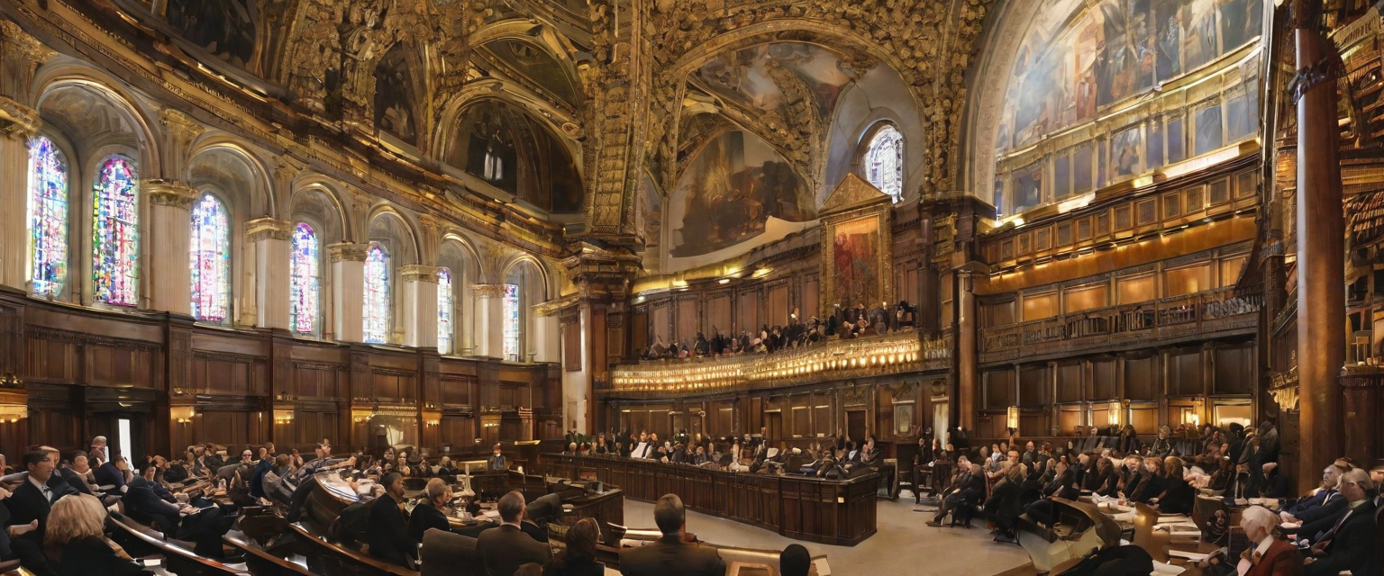
Animal Rights Legislation
Laws to Protect Animals
Animal rights legislation aims to protect animals from cruelty and ensure their well-being. These laws vary from country to country, but they generally focus on preventing animal abuse, neglect, and exploitation.
Preventing Animal Cruelty
Animal rights legislation includes regulations that specifically target animal cruelty. These laws make it illegal to engage in activities such as animal fighting, neglect, abandonment, and unnecessary harm or suffering.

Slide 19
CONCLUSION
In conclusion , Animals have the right to be treated ethically and with respect. Ethical treatment of animals is essential for a just and compassionate society and animal rights should be protected and upheld by individuals and organizations.

